Slide 1
Heidi Miller, MD
Primary Care Physician
Seán Collins
Brand Strategist

Slide 2
neither has a relationship with commercial entities related to the subject matter in this presentation
Heidi Miller, MD
Primary Care Physician
Seán Collins
Brand Strategist
Notes:
Can we

Slide 3
mr. collins is dr. miller’s patient at the family care health centers
Heidi Miller, MD
Primary Care Physician
Seán Collins
Brand Strategist
Notes:
Can we

Slide 4
WHAT WE WILL
PRESENT TODAY

Slide 5
Six areas for your reflection from our perspectives as a patient & a community physician
6
WHAT WE WILL
PRESENT TODAY

Slide 6
Six areas for your reflection from our perspectives as a patient & a community physician
1. Communication
2. Rapport
3. Unintentional Harm
4. Choice of Topics
5. Equality
6. Ecosystems
WHAT WE WILL
PRESENT TODAY

Slide 7
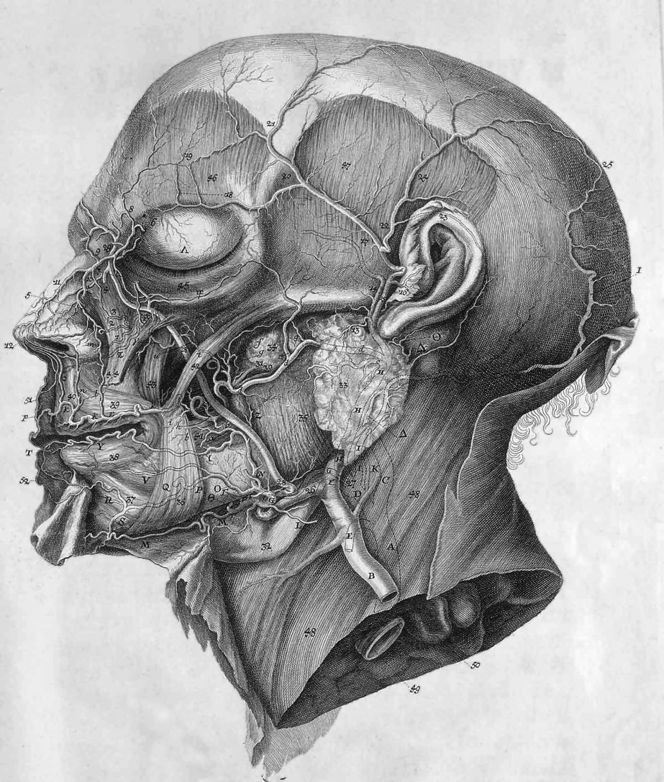
Natura in reticulum sua genera connexit,
non in catenam: homines non possunt nisi
catenam sequi, cum non plura simul
possint sermone exponere.
Albrecht von Haller
Swiss Physiologist
1708-1777

Slide 8
Nature knits up her kinds in a web,
not in a chain. But men can only follow
by chains because their language
can’t handle several things at once.
Albrecht von Haller
Swiss Physiologist
1708-1777

Slide 9
1. COMMUNICATION
Heidi Miller, MD
Primary Care Physician
Family Care Health Centers
Seán Collins
Writer & Brand Strategist

Slide 10
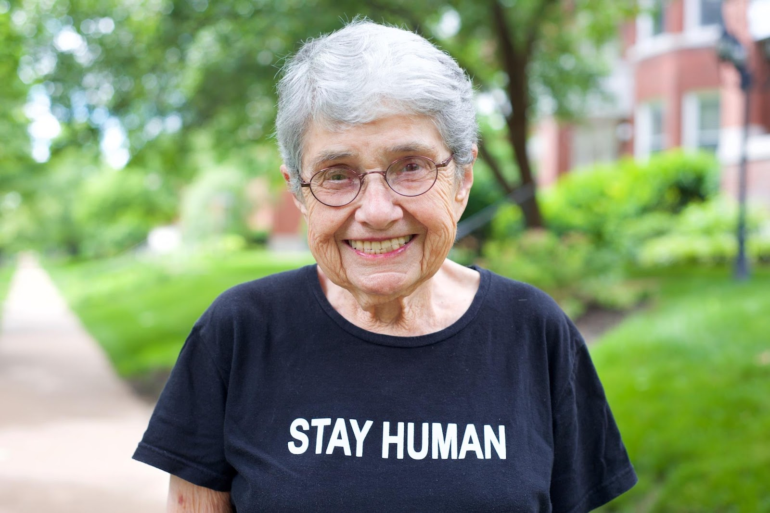
COMMUNICATION
Be authentic
Use real language
Heidi Miller, MD
Primary Care Physician
Family Care Health Centers
Seán Collins
Writer & Brand Strategist
Hedy Epstein, 1924-2016
Survivor of Nazi persecution, anti-war activist

Slide 11
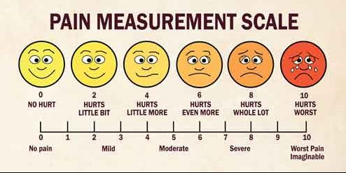
COMMUNICATION
Be authentic
Use real language
Write as a human,
to a human
Heidi Miller, MD
Primary Care Physician
Family Care Health Centers
Seán Collins
Writer & Brand Strategist

Slide 12
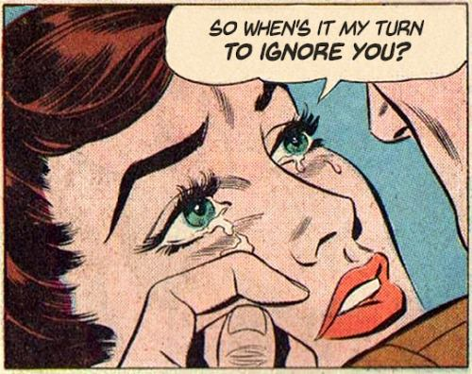
COMMUNICATION
Be authentic
Use real language
Write as a human,
to a human
Follow up with people

Slide 13
COMMUNICATION
CALL TO ACTION
Stay Human
Heidi Miller, MD
Primary Care Physician
Family Care Health Centers
Seán Collins
Writer & Brand Strategist

Slide 14
2. RAPPORT
Heidi Miller, MD
Primary Care Physician
Family Care Health Centers
Seán Collins
Writer & Brand Strategist

Slide 15
RAPPORT
No truth without trust
It takes time, trust, and a track record to produce the degree of social credentialing needed
BUT…
What if the researcher is a stranger?
What it there’s no time to build rapport?
Heidi Miller, MD
Primary Care Physician
Family Care Health Centers
Seán Collins
Writer & Brand Strategist

Slide 16
RAPPORT
How can you be patient-centered if the patient remains “other?” What does it say about the practice of medical research if there’s no time to build rapport? People vs. subjects
Heidi Miller, MD
Primary Care Physician
Family Care Health Centers
Seán Collins
Writer & Brand Strategist

Slide 17
RAPPORT
WHEN IT IS DONE WELL
Two stories from the morning of CABG surgery
Anesthesiologist Expression of care
Cardiothoracic surgeon Reciprocation
Heidi Miller, MD
Primary Care Physician
Family Care Health Centers
Seán Collins
Writer & Brand Strategist

Slide 18
RAPPORT
CALL TO ACTION
Prioritize rapport in your study design
Meet people where they are
Who meets them matters
Stay with them
Heidi Miller, MD
Primary Care Physician
Family Care Health Centers
Seán Collins
Writer & Brand Strategist

Slide 19
3. UNINTENTIONAL HARM
Heidi Miller, MD
Primary Care Physician
Family Care Health Centers
Seán Collins
Writer & Brand Strategist

Slide 20
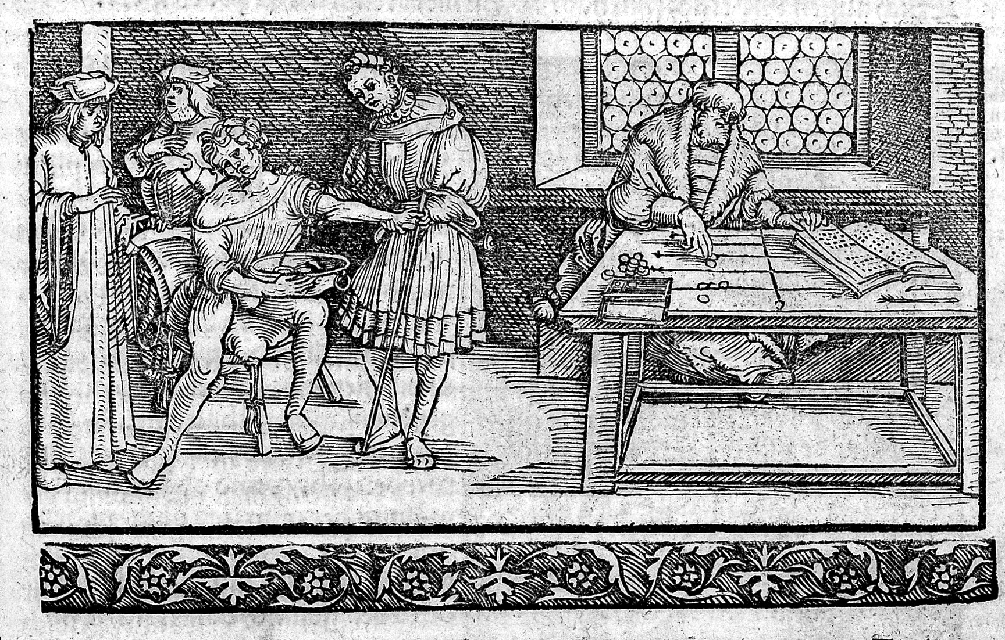
UNINTENTIONAL HARM
Iatrogenesis
Intent vs Impact
Heidi Miller, MD
Primary Care Physician
Family Care Health Centers
Seán Collins
Writer & Brand Strategist

Slide 21
UNINTENTIONAL HARM
When research is not respectful of patient autonomy and level of understanding
Heidi Miller, MD
Primary Care Physician
Family Care Health Centers
Seán Collins
Writer & Brand Strategist

Slide 22
UNINTENTIONAL HARM
When the provider is researcher
Morning of CABG, being asked to participate in a study
When all the lung cancer chemotherapies have failed
Heidi Miller, MD
Primary Care Physician
Family Care Health Centers
Seán Collins
Writer & Brand Strategist
Notes:
Pt with lung cancer, rather than being offered a second opinion, is offered provider’s own study.

Slide 23
UNINTENTIONAL HARM
When informed consent harms
Sleep and “heart failure” study
Heidi Miller, MD
Primary Care Physician
Family Care Health Centers
Seán Collins
Writer & Brand Strategist

Slide 24
UNINTENTIONAL HARM
When survey questions induce anxiety and confusion
Pt with Parkinson’s disease
Heidi Miller, MD
Primary Care Physician
Family Care Health Centers
Seán Collins
Writer & Brand Strategist
Notes:
– needing dx, tx, and then 50 questions – is asked about dementia.
Trauma-informed care includes trauma-informed research, ie. Not re-traumatizing patients through research.

Slide 25
UNINTENTIONAL HARM
When your questions cause a sense of abandonment
Mood and social stressor query at orthopedic office
Heidi Miller, MD
Primary Care Physician
Family Care Health Centers
Seán Collins
Writer & Brand Strategist
Notes:
(if no f/u).
– when the answers are ‘yes’ and there’s no follow up.

Slide 26
UNINTENTIONAL HARM
The anxiety/trauma of being randomized in a controlled trial
Am I being helped?
Or am I being passed over?
Heidi Miller, MD
Primary Care Physician
Family Care Health Centers
Seán Collins
Writer & Brand Strategist

Slide 27
UNINTENTIONAL HARM
CALL TO ACTION
First, do no harm
Look through a trauma-informed lens
Heidi Miller, MD
Primary Care Physician
Family Care Health Centers
Seán Collins
Writer & Brand Strategist

Slide 28
4. CHOOSING RESEARCH TOPICS
Heidi Miller, MD
Primary Care Physician
Family Care Health Centers
Seán Collins
Writer & Brand Strategist

Slide 29
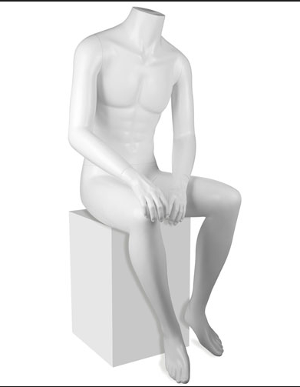
CHOOSING RESEARCH TOPICS
Variables vs. Valuable Results
Carving out one body part
Isolating one disease
Siloing interventions in one place
Overemphasizing pathology
Heidi Miller, MD
Primary Care Physician
Family Care Health Centers
Seán Collins
Writer & Brand Strategist

Slide 30
CHOOSING RESEARCH TOPICS
Variables vs. Valuable Results
Carving out one body part
Isolating one disease
Siloing interventions in one place
Overemphasizing pathology
“Nature knits up her kinds in a web,
not in a chain. But men can only follow by chains because their language can’t handle several things at once.” Albrecht von Haler
Heidi Miller, MD
Primary Care Physician
Family Care Health Centers
Seán Collins
Writer & Brand Strategist

Slide 31
CHOOSING RESEARCH TOPICS
Please… Patient-Centered Topics
“Nature knits up her kinds in a web,
not in a chain. But men can only follow by chains because their language can’t handle several things at once.” Albrecht von Haler
Heidi Miller, MD
Primary Care Physician
Family Care Health Centers
Seán Collins
Writer & Brand Strategist

Slide 32
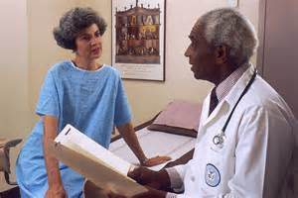
CHOOSING RESEARCH TOPICS
Please… Patient-Centered Topics
Not spleen-centered
Not researcher-centered
Not hospital-centered
Not doctor-centered
Not body-centered
Heidi Miller, MD
Primary Care Physician
Family Care Health Centers
Seán Collins
Writer & Brand Strategist

Slide 33
CHOOSING RESEARCH TOPICS
Please… Patient-Centered Topics
How do we achieve health equity
- Instead of just measuring health disparities
How do we promote health
- Instead of just treating our pathologies after they develop
How do we juggle more than one disease
-Multi-morbidity is everywhere
How do we push further upstream
- SDOH, institutional racism, intergenerational inequities
Continuity-of-care and transitions-of-care
- Center on our patients’ needs through time and space
Heidi Miller, MD
Primary Care Physician
Family Care Health Centers
Seán Collins
Writer & Brand Strategist
Notes:
study these VITAL pt-centered topics:

Slide 34
CHOOSING RESEARCH TOPICS
CALL TO ACTION
Don’t be blasé about “patient-centered”
Lean in to research complexities
Push beyond reductionism
Surpass your predecessors
Heidi Miller, MD
Primary Care Physician
Family Care Health Centers
Seán Collins
Writer & Brand Strategist

Slide 35
5. EQUALITY
Heidi Miller, MD
Primary Care Physician
Family Care Health Centers
Seán Collins
Writer & Brand Strategist

Slide 36
EQUALITY
WHO IS THE EXPERT?
Brand strategy:
“Thought Leaders”
Community health:
“Content experts”
Lived experience is crucial
Authentic shared decision-making
Heidi Miller, MD
Primary Care Physician
Family Care Health Centers
Seán Collins
Writer & Brand Strategist
Notes:
You? Or your “subjects?”
Not necessarily your professors and
academic mentors
Then who? (and what do you call them?)

Slide 37
EQUALITY
WHO IS THE EXPERT?
“A basic tenet of shared decision making is that clinicians are the experts in the evidence and patients are the experts in what matters most to them.”
Heidi Miller, MD
Primary Care Physician
Family Care Health Centers
Seán Collins
Writer & Brand Strategist
ES Spatz, et al.
JAMA April 2017; 317(13:1309-1310

Slide 38
EQUALITY
WHO BENEFITS FROM THE RESEARCH?
There is no hierarchy
Remember your mission is not their mission
Mutual benefit in research collaborations
Value-added partnerships
Don’t ask for something for nothing
Red flag for “lip service” or “window dressing”
Heidi Miller, MD
Primary Care Physician
Family Care Health Centers
Seán Collins
Writer & Brand Strategist
Notes:
Don’t use
Force for good - everyone benefits,
each treated with respect
Don’t pull patients and community organizations to only meet your goals.
Value-added partnerships: what can you do/provide for your participating patients and community organizations
Paying for their time $100/hr - PCOR (thank you)
Remember pt’s needs and organization’s mission may not be yours.
Red flag for “lip service” or “window dressing”

Slide 39
EQUALITY
CALL TO ACTION
Respect Your Experts
Heidi Miller, MD
Primary Care Physician
Family Care Health Centers
Seán Collins
Writer & Brand Strategist

Slide 40
6. ECOSYSTEMS
Heidi Miller, MD
Primary Care Physician
Family Care Health Centers
Seán Collins
Writer & Brand Strategist

Slide 41
ECOSYSTEMS
Remember what von Haller said:
“Nature knits her kinds together
in a web, not in a chain…”
The reality of the world is that
our clinical interactions are not linear:
they are multi-dimensional.
That is true for EVERY clinical encounter.
Heidi Miller, MD
Primary Care Physician
Family Care Health Centers
Seán Collins
Writer & Brand Strategist

Slide 42
ECOSYSTEMS
“Unlike other objects in science, persons
cannot be reduced to their parts in order
to better understand them.”
Eric Cassell, MD
The Nature of Suffering and the Goals of Medicine
Heidi Miller, MD
Primary Care Physician
Family Care Health Centers
Seán Collins
Writer & Brand Strategist

Slide 43
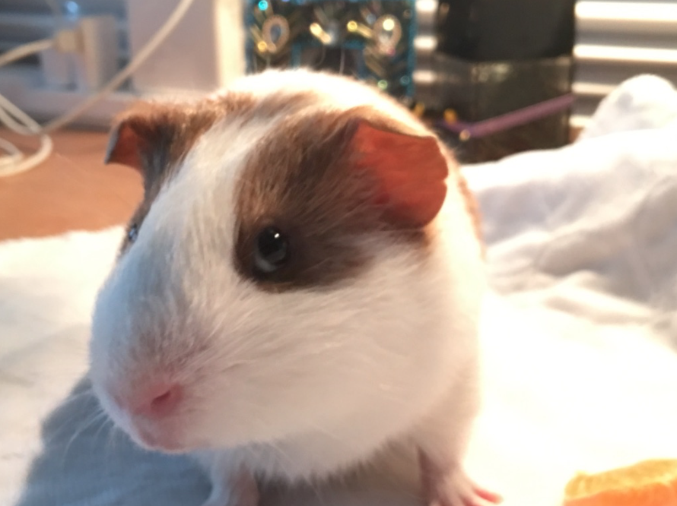
ECOSYSTEMS
Heidi Miller, MD
Primary Care Physician
Family Care Health Centers
Seán Collins
Writer & Brand Strategist

Slide 44
ECOSYSTEMS
CALL TO ACTION
Honor the beauty and complexity of the human state
Heidi Miller, MD
Primary Care Physician
Family Care Health Centers
Seán Collins
Writer & Brand Strategist

Slide 45
Our Calls to Action
1. Communication: - Stay Human
2. Rapport: - Prioritize rapport
- Meet people where they are
- Who meets them matters
- Stay with them
3. Unintentional Harm: - First do no harm
- Trauma-informed lens
4. Choice of Topics: - “Patient-centered”
- Lean in, push beyond, surpass
5. Equality: - Respect your experts
6. Ecosystems: - Honor the beauty and complexity of the human state

Slide 46
Thank You
Heidi Miller, MD
Primary Care Physician
Family Care Health Centers
Seán Collins
Writer & Brand Strategist

